Slide 1
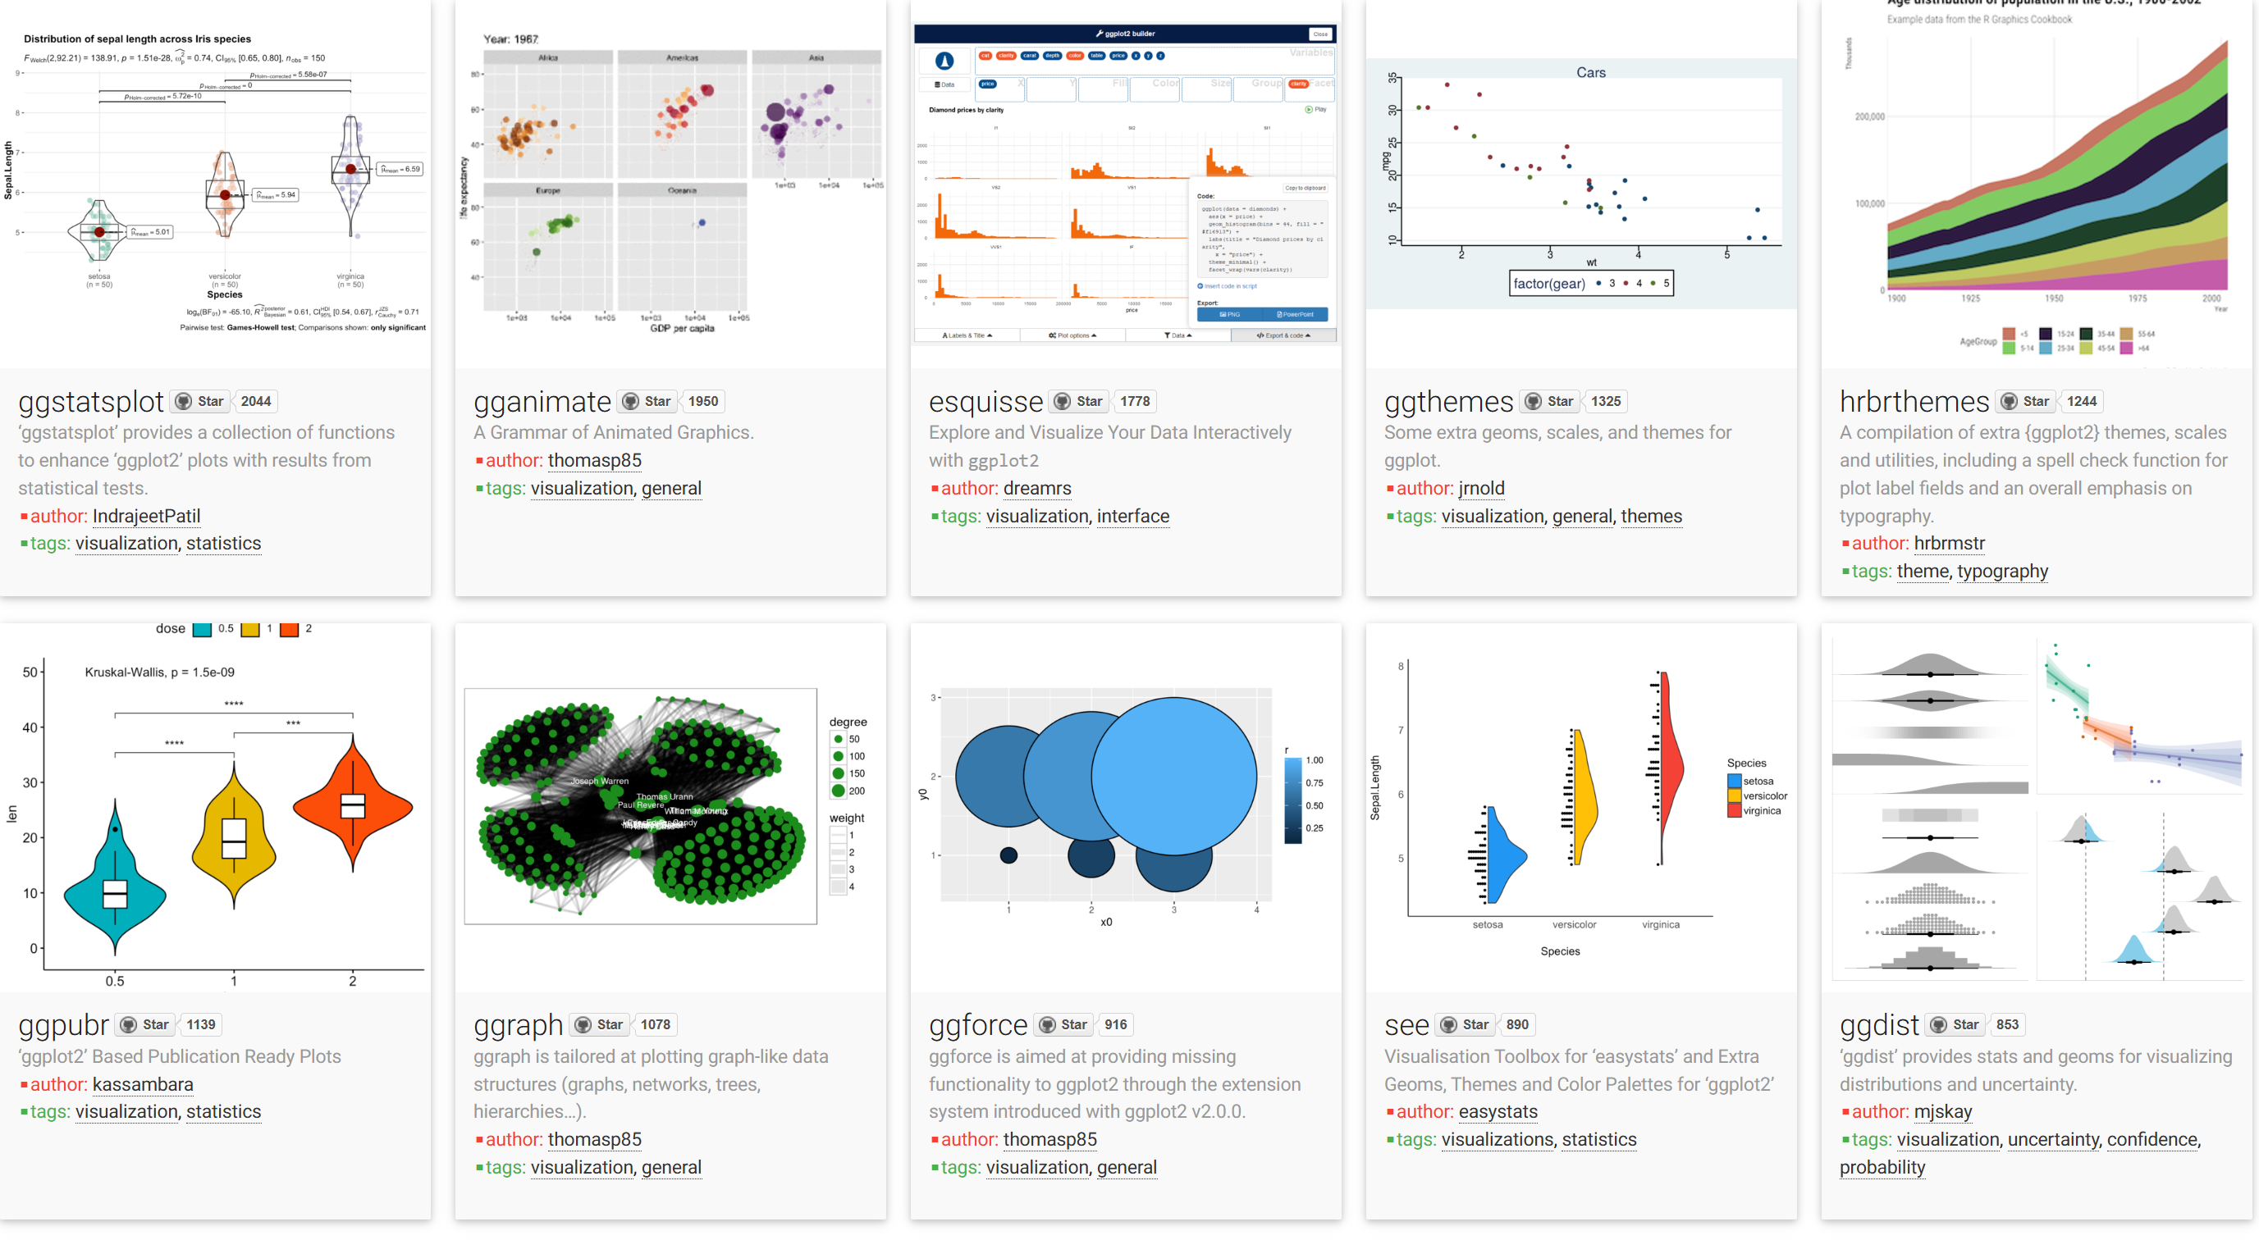

The wonderful world of Data visualization with ggplot2 in R-Studio
Academic Performance for the ASTRAI
William Jr. Marmol Romero

Slide 2
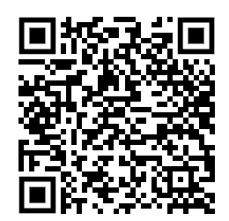
QR Code to the files for the excersise
https://drive.google.com/drive/folders/17_mmsTa3TtHLS92XXcdhirKeIxFKFjN2?usp=drive_link

Slide 3
Agenda
1 Why data visualization?
6 A universe of possibilities
2 Let's talk about ggplot2
7 End
3 Geoms and Aesthetics
4 Facets
5 Labels and annotations

Slide 4
1. Why data visualization?
A picture is worth a thousand words
Confucius? Fred R. Bernard in 1921?
There is magic in graphs. The proﬁle of a curve reveals in a ﬂash a whole situation — the life history of an epidemic, a panic, or an era of prosperity. The curve informs the mind, awakens the imagination, convinces.
Henry D. Hubbard, 1939

Slide 5
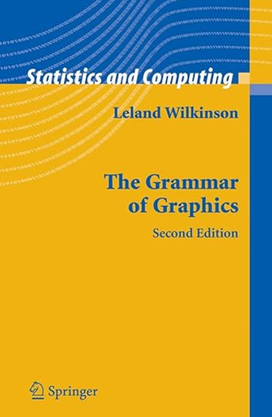
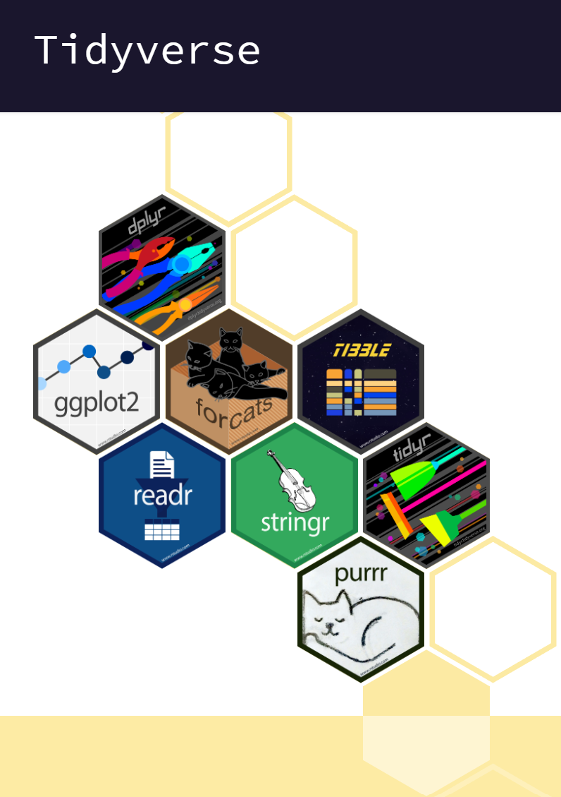
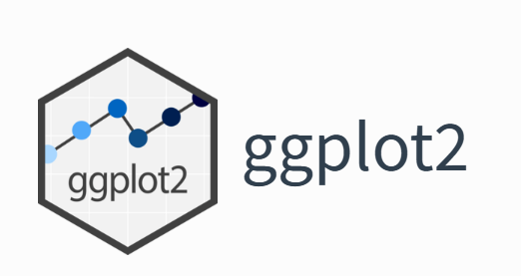
2. Let's talk about ggplot2
Collection of R-Packages
Most popular package for data visualization in R
By statistician and developer
Hadley Wickham, 2005
Create and manipulate as you want
Source: tidyverse.org, 2024

Slide 6
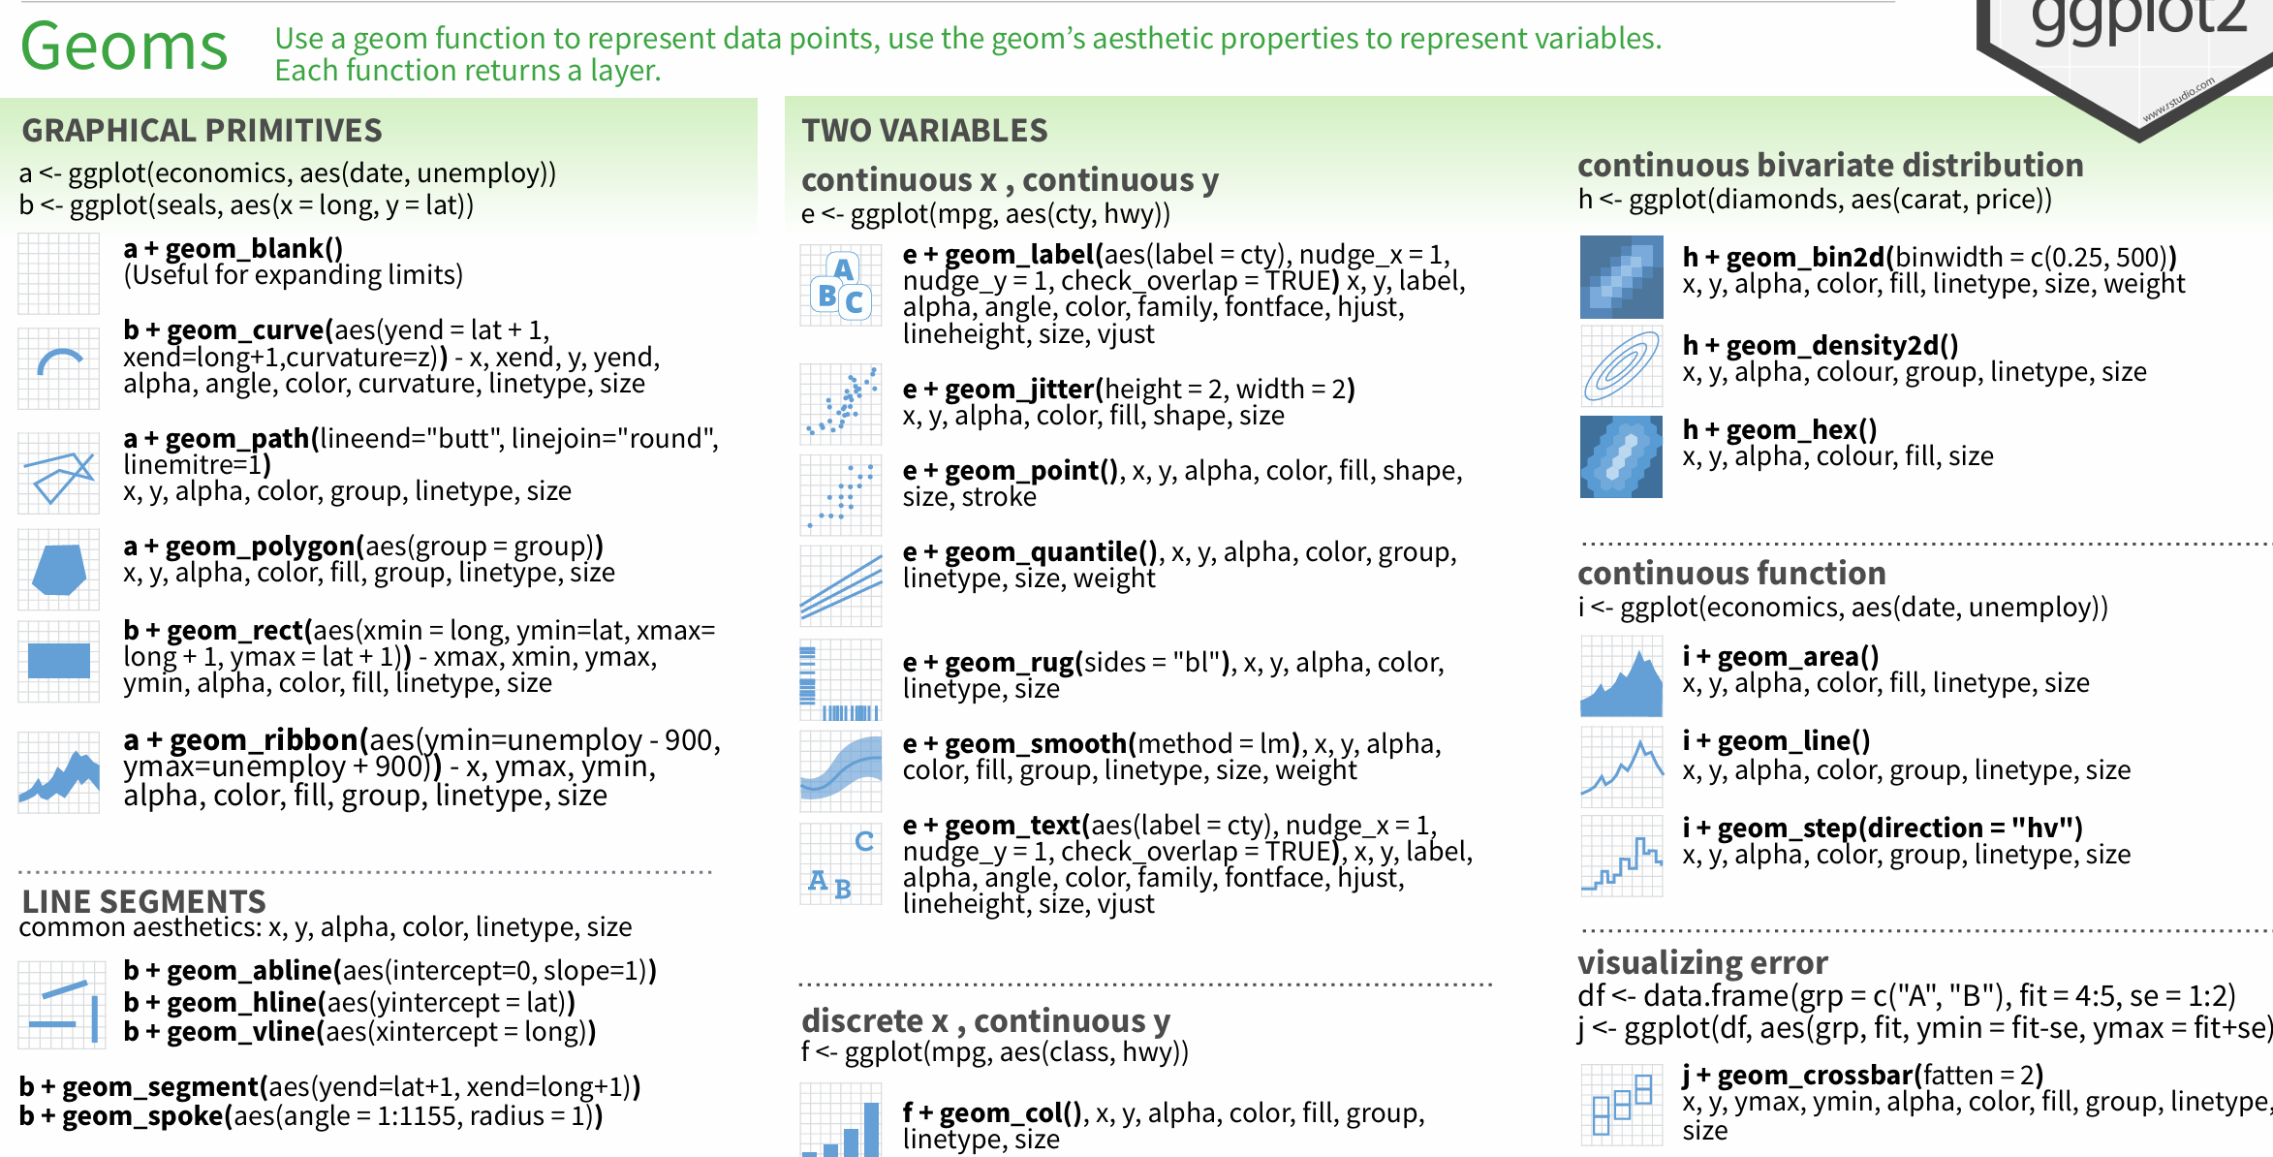
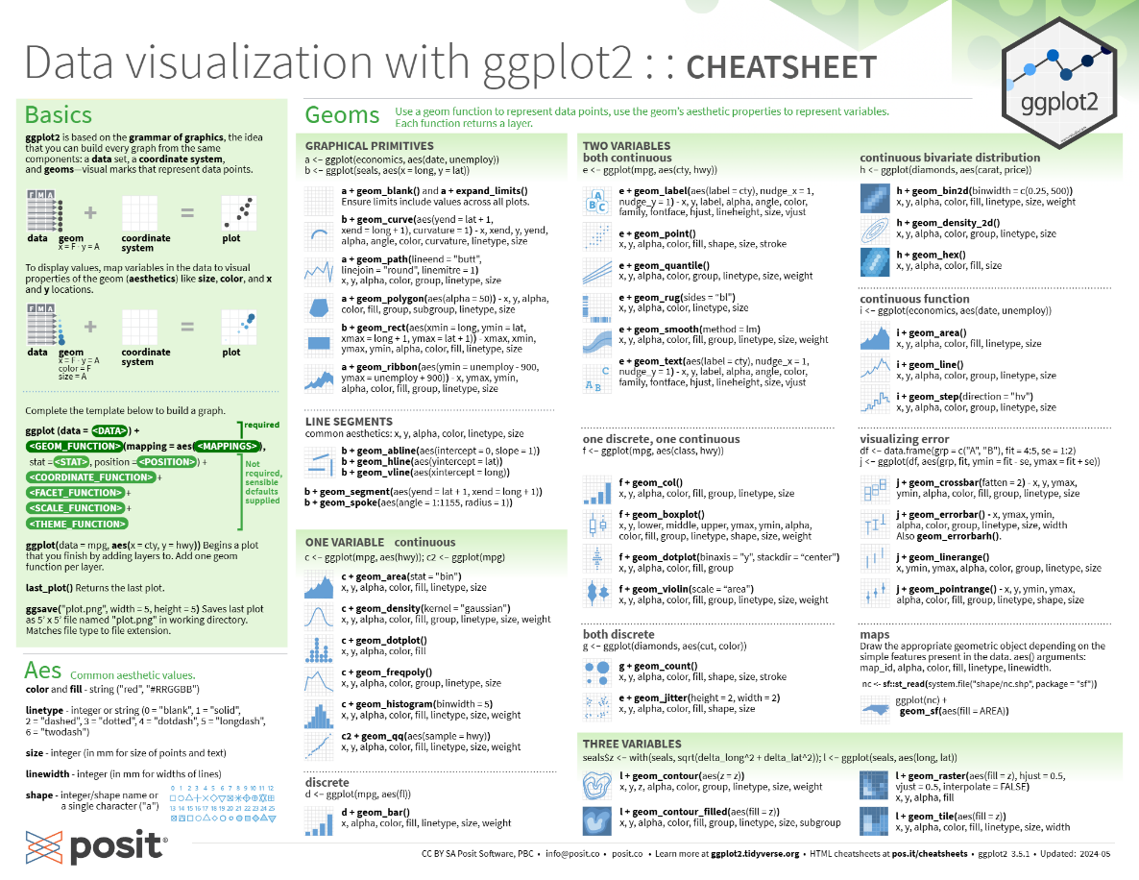
2. Let's talk about ggplot2
Source: r-studio git repository , 2024
https://github.com/rstudio/cheatsheets/blob/main/data-visualization.pdf

Slide 7
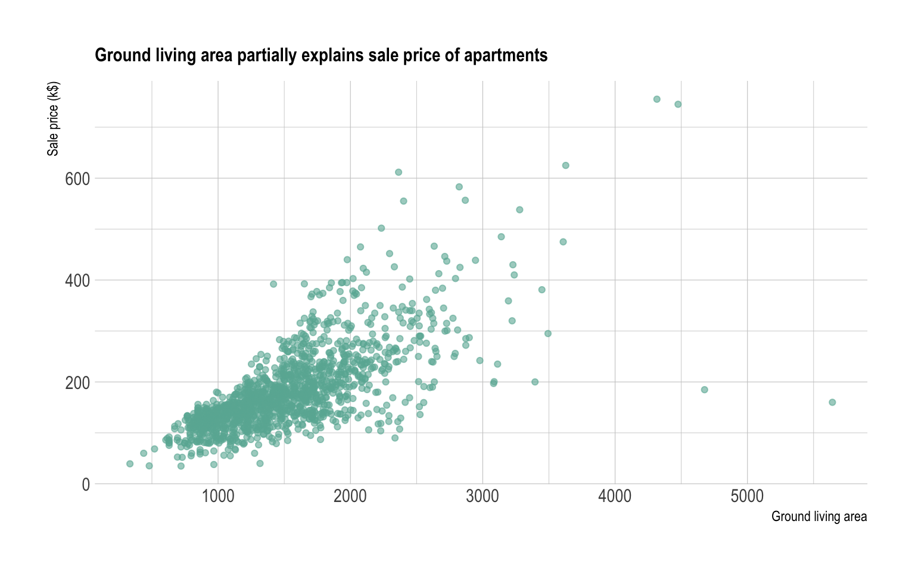
3. Geoms and Aesthetics
Aesthetic
Are visual properties of an object in the plot
Size
Shape
Color of the data points
Source: data-to-viz, 2024

Slide 8
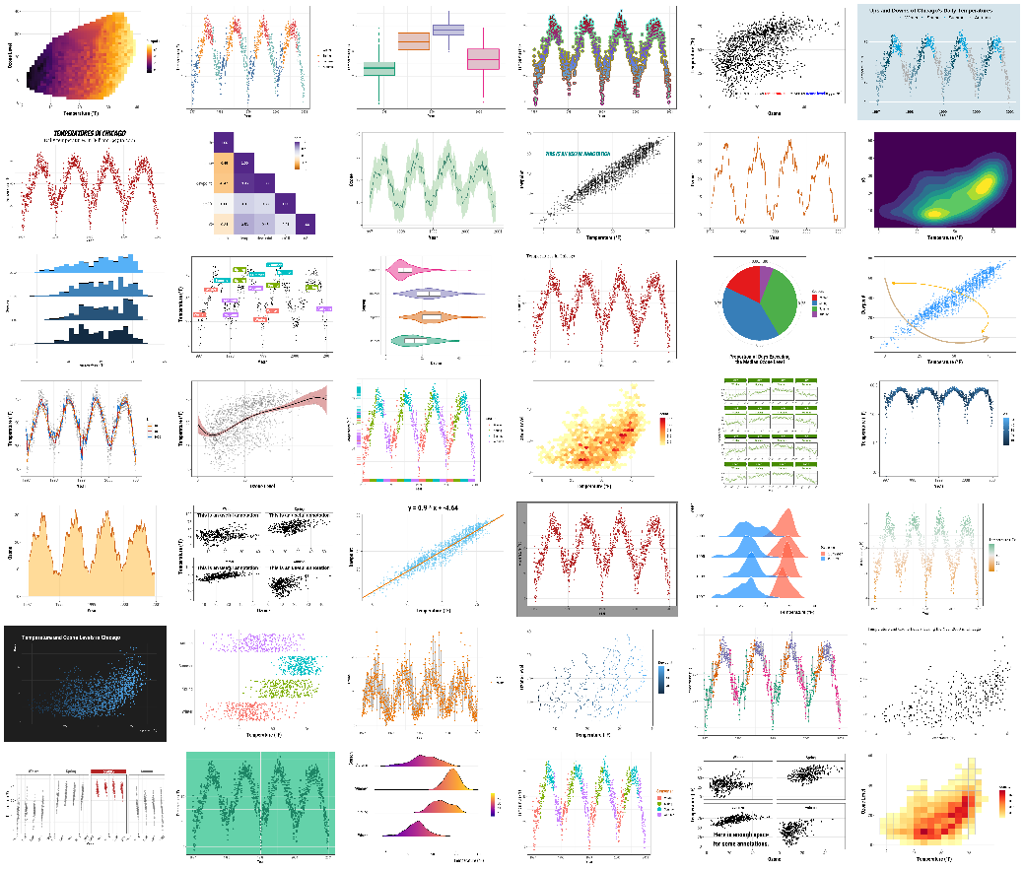
3. Geoms and Aesthetics
Geom
Is the geometric object used to represent the data
Points
Bars
Lines…
Whatever fits the data in the best way for your purpose
Source: https://www.cedricscherer.com/, 2019

Slide 9
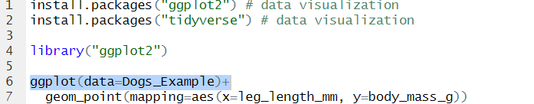
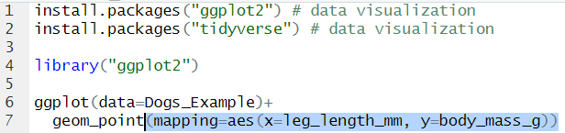
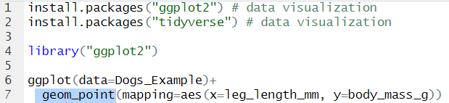
3. Geoms and Aesthetics
Layers over layers…
1. Data frame:
3. Aesthetic:
Matching/mapping variables to aesthetics
2. Geom:

Slide 10
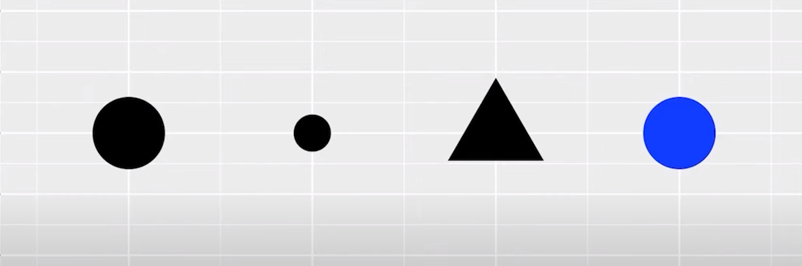
3. Geoms and Aesthetics
Aesthetics
Visual properties
Let's play with the aesthetics of our plots…
Source: Google Data Analyst Certificate, 2021

Slide 11
4. Facets functions
Let you display smaller groups, or subsets, of your data. They help you to place each subset in a different plot. The possibilities for analysis are expanded.
ggplot2 has:
facet_wrap() – a single variable
facet_grid() – multiple variables

Slide 12
5. Labels and ANNOTATIONs
To add notes to a document or diagram to explain, comment or emphasize upon it .
Labels:
Title
Subtitles
Captions
Annotations:

Slide 13
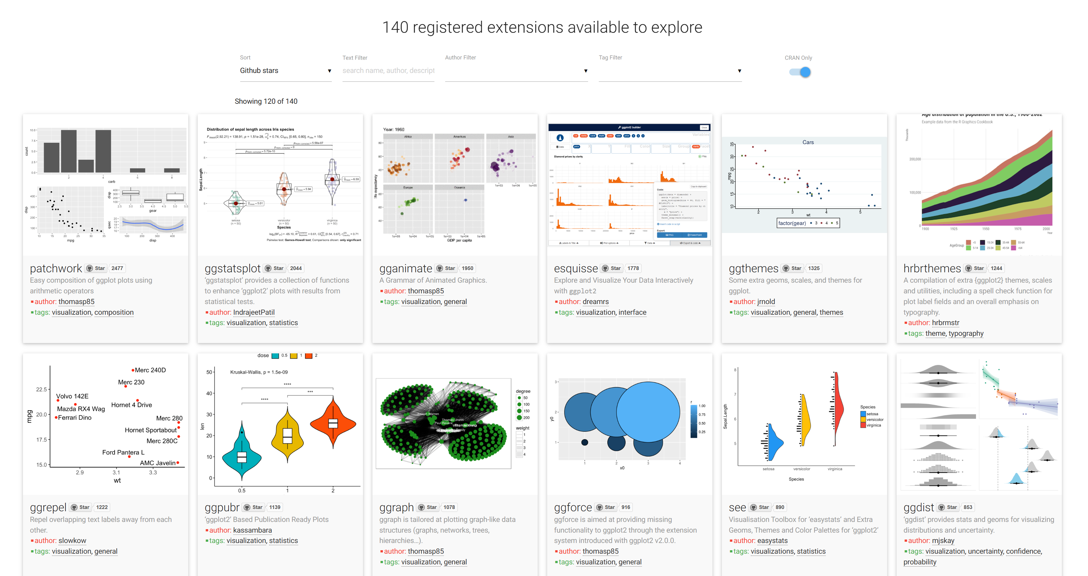
6. A universe of possibilities
ggplot 2 has over 30 geom functions and extension packages like the 140 registered in https://exts.ggplot2.tidyverse.org/gallery/ give us a wider universe of amazing possibilities for our graphics
Source: tidyverse.org, 2024

Slide 14
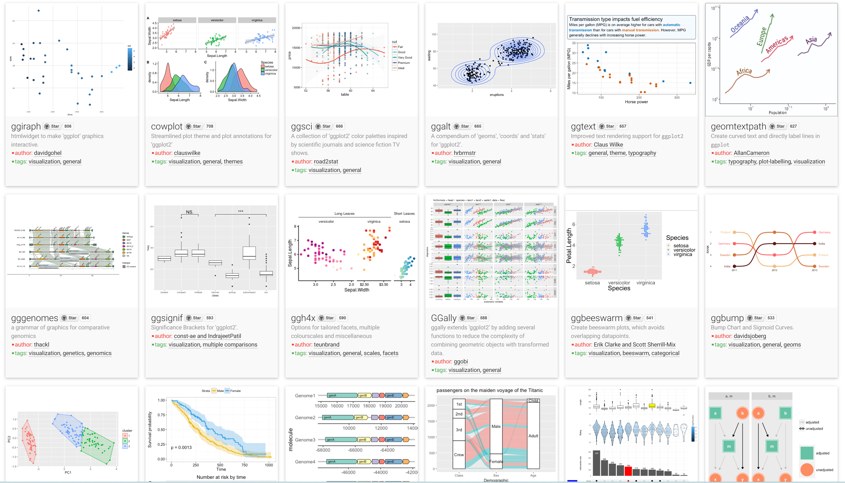
6. A universe of possibilities
Source: tidyverse.org, 2024

Slide 15
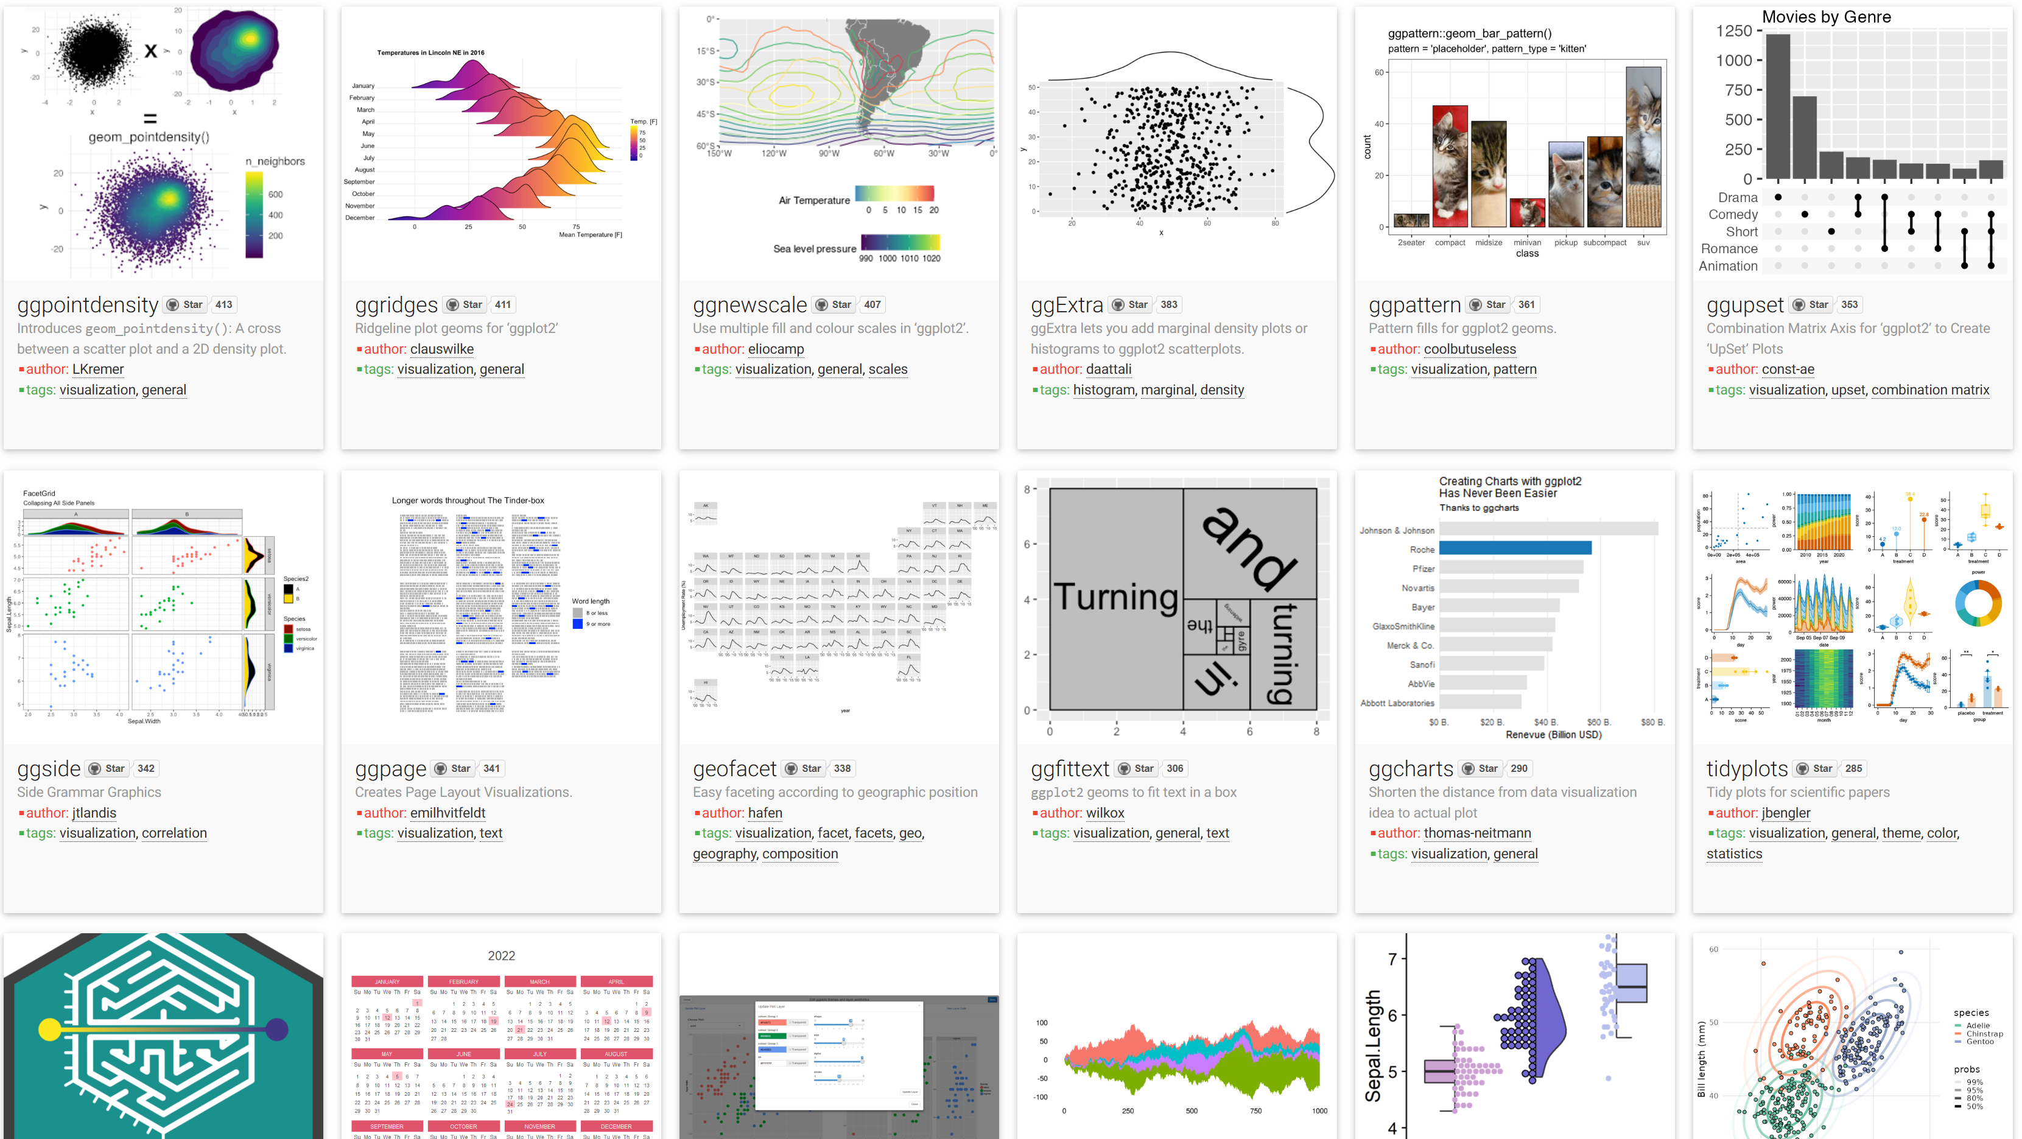
6. A universe of possibilities
Source: tidyverse.org, 2024

Slide 16

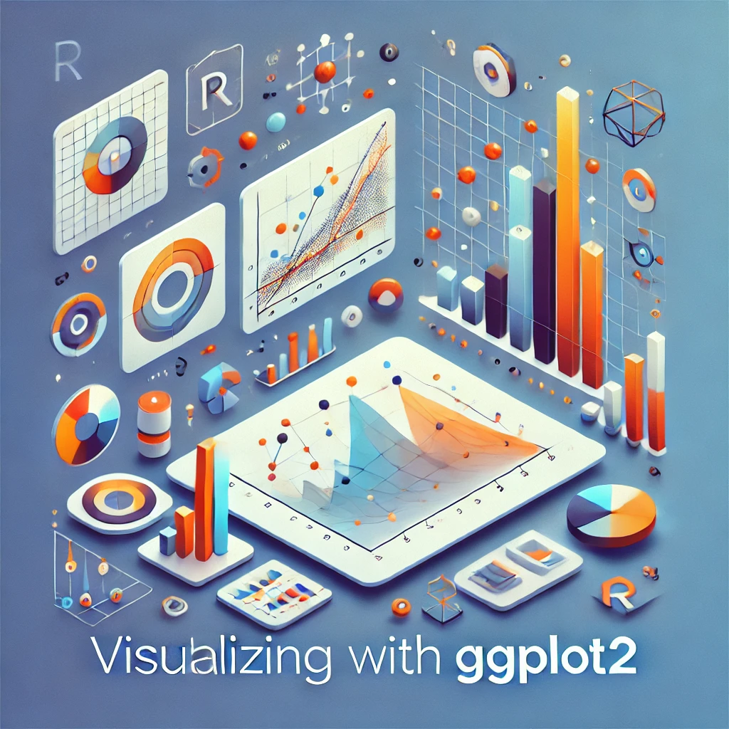
7. Thank You
Source: Dall-E (AI generated), 2024

